Slide 1
Machine Learning Term Project
정두화, 이정명, 최찬영, 허서윤

Slide 2
100%
Classification
&
Clustering
Wise Prophet
&
Member rules
Project title
01
02
03

Slide 3

01
Project Title

Slide 4
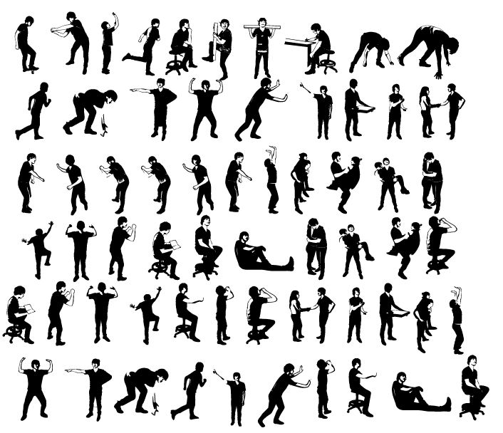
100%
Project Title
Watching motion and predicting what action to take

Slide 5
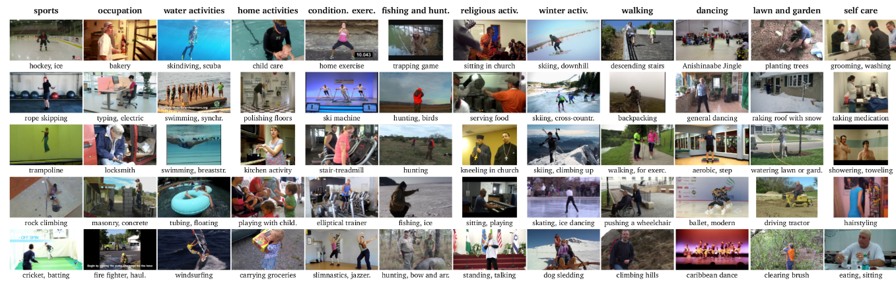
100%
Dataset
MpII Human Pose Dataset in Kaggle
MPII Human Pose dataset is a state of the art benchmark for evaluation of articulated human pose estimation. The dataset includes around 25K images containing over 40K people with annotated body joints. The images were systematically collected using an established taxonomy of every day human activities. Overall the dataset covers 410 human activities and each image is provided with an activity label.
Dataset URL : https://www.kaggle.com/nicolehoelzl/mpii-human-pose-data

Slide 6
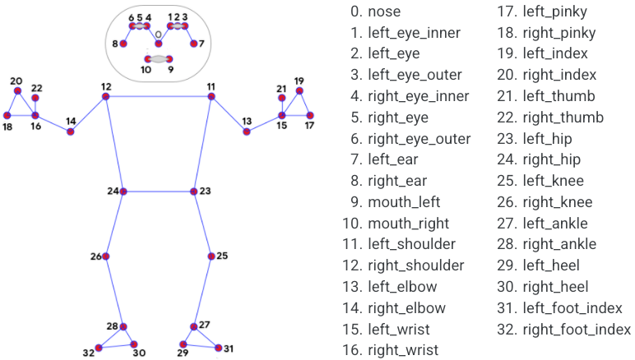
100%
Library
Motion Tracking Library
Dataset URL : https://google.github.io/mediapipe/solutions/pose.html

Slide 7
100%
Library
Problem
Solution
Get the value through other features.
Example)
-The average of both hips -> pelvis
-The average of both shoulders and pelvis's 2:1 endocrine point -> torax
-The average point of both shoulders and nose -> upper neck
-The outer part of the shoulders and nose -> head top
Among these columns, pelvis, thorax, head top, upper neck will be excluded.
Dataset URL : https://google.github.io/mediapipe/solutions/pose.html

Slide 8
100%
Project Idea
We will create a program to
“find out what posture this person is currently taking”
by using a dataset with coordinates for each body part.
Motion Tracking
&
Extract pose (x,y)
YOGA
input
output
Preprocessing
Find Best Model
Fitting Model

Slide 9
02
Classification & Clustering

Slide 10
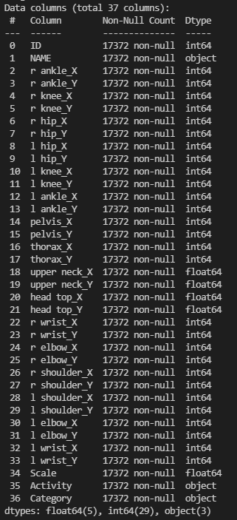
100%
Datasize
17372 rows X
37 attributes

Slide 11
100%
Classification Algorithm
Clustering Algorithm
Decision tree
2. Logistic regression
3. SVM
Meanshift
K-Means
GMM
AgglomerativeClustering
Most influence the classification accuracy in Dataset
Col 2 ~ Col 33 in dataset A have a joint point. The pose has to be combined with each feature, so it is expected that it will inevitably affect all of the classifications.

Slide 21
100%

Slide 22
100%

Slide 23
100%

Slide 24
03
Wise Prophet & Member rules

Slide 25
100%
Project Schedule
MON | TUE | WED | THU | FRI | SAT | SUN
18 | 19 | 20 | 21 | 22 | 23 | 24
25 | 26 | 27 | 28 | 29 | 30 | 31
11.1 | 2 | 3 | 4 | 5 | 6 | 7
8 | 9 | 10 | 11 | 12 | 13 | 14
15 | 16
Proposal
Preprocessing
Meeting
Making
Classification / Clustering
Function
Meeting
Meeting
Finishing work & Prepare Final Presentation
Final

Slide 26
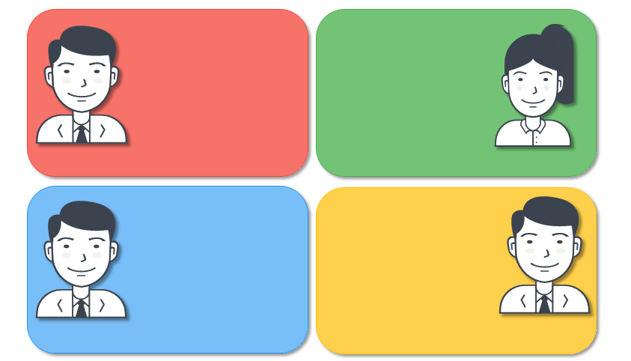
100%
정두화
Pre-processing
Classification-
Decision Tree,
Logistic
허서윤
Clustering - MeanShift
이정명
Classification-
SVM
최찬영
Clustering-
KMeans
GMM
Aggolmerative

Slide 27
100%
Thank you

